Slide 1
AtliQ Grands Hospitality Industry
ANALYSIS

Slide 2
INTRODUCTION
AtliQ Grands is a premium hotel chain operating across multiple cities, offering high-quality accommodation and hospitality services.
The brand manages a diverse portfolio of properties ranging from luxury hotels to business-class establishments.
With a strong focus on customer experience, AtliQ Grands provides various room categories, modern amenities, and seamless booking options through multiple platforms.
As part of the competitive hospitality industry, the company aims to maximize occupancy, optimize revenue, and deliver exceptional guest satisfaction across all its properties.
The dashboard built during this capstone project enables data-driven decision-making to improve overall hotel performance and operational efficiency.

Slide 3
OBJECTIVES
Understand and analyse hotel performance across different properties and room types and build important hospitality KPIs such as:
ADR (Average Daily Rate)
RevPAR (Revenue per available room)
Occupancy%
SRN (Sellable room nights)
DSRN (Daily sellable room nights)
URN (Utilized Room Nights)
BRN (Booked Room Nights).
2. Identify booking patterns, cancellations, no-shows, platform usage, and revenue insights.
3. Provide an interactive dashboard for decision-making and improve data quality through cleaning, transformations, and modelling.

Slide 4
DATA OVERVIEW
The following has 5 tables out of which some of the columns are mentioned below:
Date table (date, week no, day_type, mmm yy)
Property details (property_id, name, city, category)
Room details (room_id, room_class, capacity)
Booking information (booking_id, booking_date, status, room type, number of guests, rating)
Financials (revenue_generated, revenue_realized)

Slide 5
KEY PERFORMANCE INDICATOR
For the following we are using Key Performance Indicators such as:
ADR (Average Daily Rate): The average revenue earned per room that was actually sold.
RevPAR (Revenue per Available Room): The revenue generated per available room, whether sold or not.
Occupancy %: The percentage of available rooms that were occupied.
SRN (Sellable Room Nights): The total number of rooms that can be sold during a given period.
DSRN (Daily Sellable Room Nights): The number of rooms available for sale on a single day.
URN (Utilized Room Nights): The total number of rooms that were actually occupied.
BRN (Booked Room Nights): The total rooms booked, including stays, cancellations, and no-shows.

Slide 6
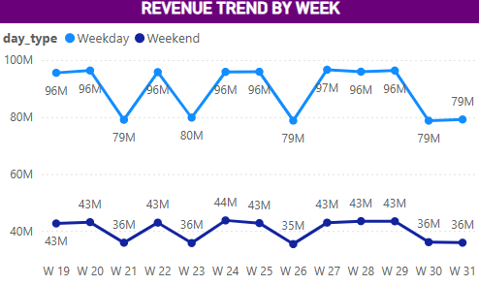
Weekday revenue remains significantly higher than weekend revenue across all weeks, consistently ranging around 79 M to 96 M.
Both weekday and weekend revenues show a recurring up-and-down pattern, suggesting weekly demand fluctuations.
A noticeable dip appears in the final week, where both weekday (79M) and weekend (36M) revenues decline, indicating a possible drop in bookings during that period.

Slide 7
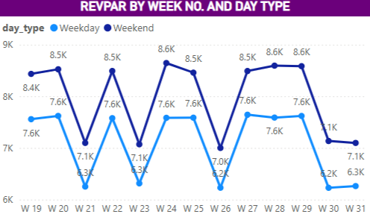
Weekend REVPAR consistently outperforms weekday REVPAR, showing stronger demand and higher revenue generation during weekends across all weeks.
Both weekday and weekend REVPAR exhibit a repeating pattern of peaks and dips, suggesting cyclical demand fluctuations tied to weekly guest behavior.
Despite the variations, weekend REVPAR maintains a higher and more stable range, indicating effective pricing and occupancy strategies during high-demand periods.

Slide 8
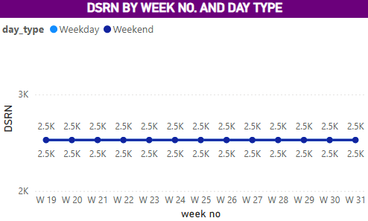
The DSRN (Daily rate for 1 night stay) remains consistently stable across all weeks, with rates holding steady at approximately 2.5K regardless of the time period.

Slide 9
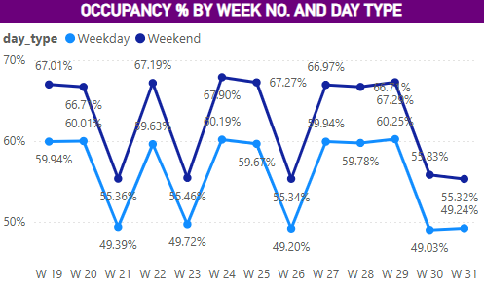
Occupancy rates show notable variability, with weekends experiencing lower occupancy compared to weekdays, particularly in Weeks 21, 23, 26 and 30.
Despite some fluctuations, weekday occupancy remains relatively stable around 60-67%, while weekend occupancy fluctuates more significantly, with a low of 49.03% in Week 31.
A sharp decline in weekend occupancy is observed in Week 30, dropping to just 55.83%, suggesting potential challenges in weekend demand during that period

Slide 10
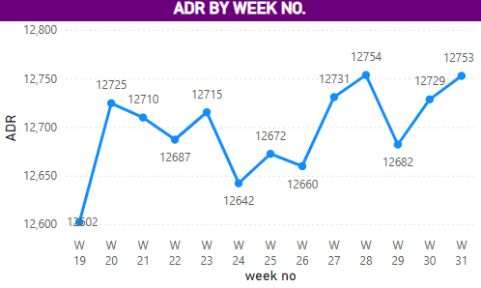
ADR shows a generally upward trend from Week 19 to Week 31, indicating strengthening room-rate performance over the period.
Despite minor week-to-week fluctuations, ADR consistently stays within a healthy band, reflecting stable demand and effective pricing strategies.
The peaks in Weeks 27 and 31 suggest periods of higher revenue optimization, aligning with stronger booking activity or targeted rate management.

Slide 11
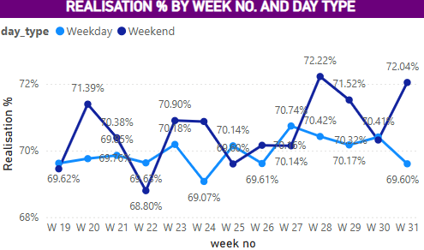
Realisation percentages show steady performance throughout the period, with weekdays consistently outperforming weekends.
Initial weeks showed 71–72% realization which dropped spontaneously on Week 22 for weekend.
While weekday realisation remains stable around 70%, weekend realisation shows more variability, reaching a peak of 72.22% in Week 28.
Both weekday and weekend realisation percentages experience similar trends, with occasional spikes, particularly in Weeks 23, indicating higher occupancy or better pricing strategies.

Slide 12
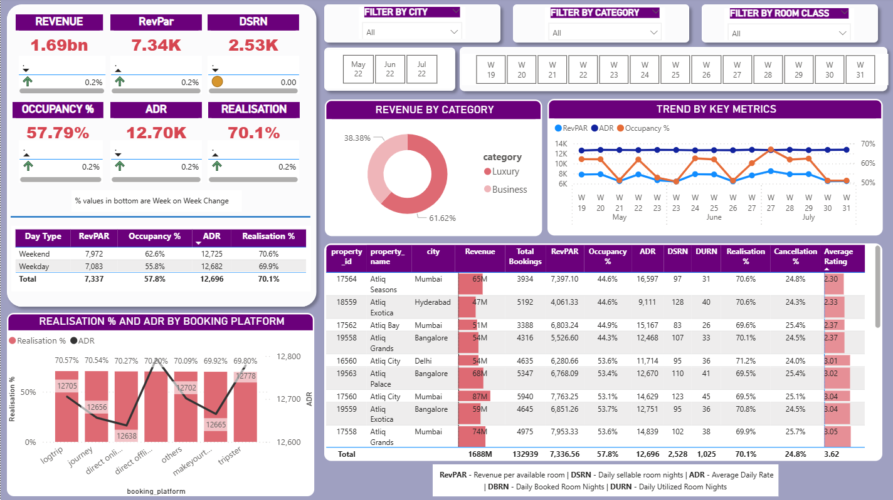
POWER BI DASHBOARD

